Slide 1
Scientific Programming
CURVE FITTING
Ankara University
Computer Engineering Department

Slide 2
Curve Fitting
Many problems require a functional relationship (curve) among one or more independent variables and a dependent variable for a given set of data points, say (x_{i}, y_{i}) for i = 1, 2, 3, ...
Curve Fitting is the determining the coefficients of such a function.

Slide 3
Curve Fitting
There are two types of application:
  Trend analysis: Predicting values of dependent variable, may include extrapolation beyond data points or interpolation between data points.
  Hypothesis testing: Comparing existing mathematical model with measured data.

Slide 4
Curve Fitting
There are two general approaches to curve fitting:
  Data exhibit a significant degree of scatter. The strategy is to derive a single curve that represents the general trend of the data.
  Data is very precise. The strategy is to pass a curve or a series of curves through each of the points.

Slide 5
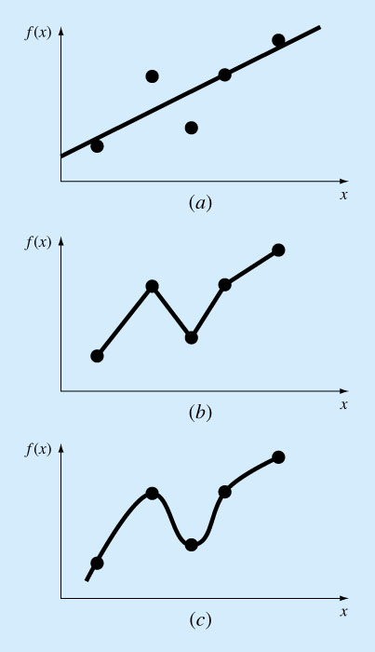
Curve Fitting

Slide 6
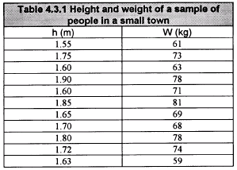
Least Squares Regression
Linear Regression
Consider, for example, the data given in the following Table which is collected from a survey of randomly selected people between the ages of 10 - 50 in a small town.

Slide 7
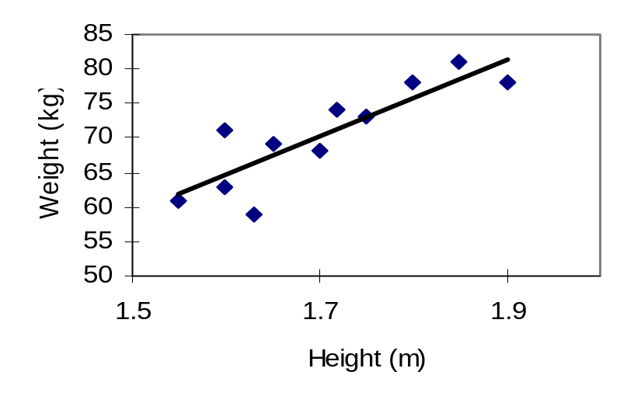
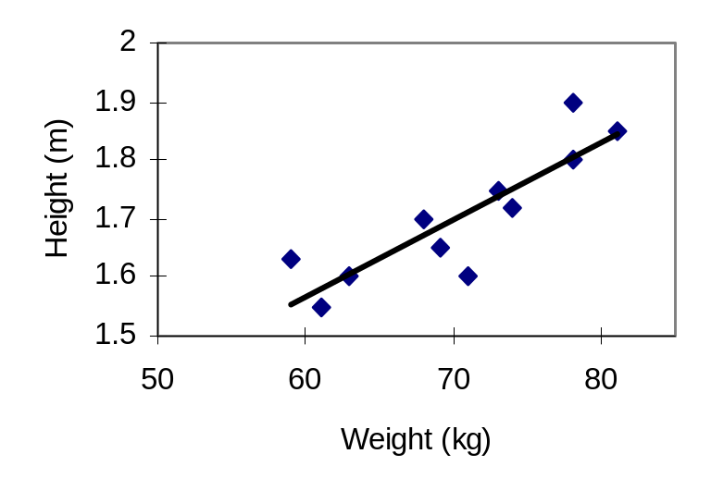
Least Squares Regression
h = a + bw w = c + dh
Least squares regression is a method that calls for minimization of
the sum of the squares of the components of the error vector E_{i}.

Slide 8
Least Squares Regression
Linear Regression
Fitting a straight line to a set of paired observations:
  (x₁, y₁), (x₂, y₂),…,(x_{n}, y_{n}).
  y=a₀+a₁x+e
  a₁- slope
  a₀- intercept
  e- error, or residual, between the model and the observations

Slide 9
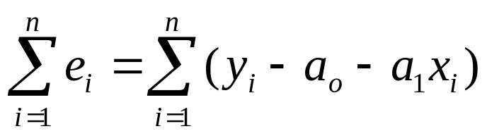
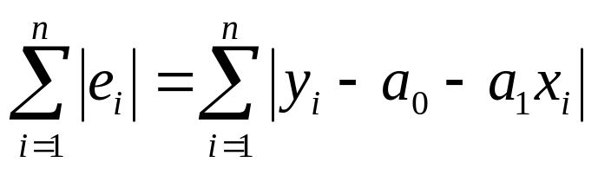
Least Squares Regression
Linear Regression
Minimize the sum of the residual errors for all available data:
n = total number of points
However, this is an inadequate criterion, so is the sum of the absolute values

Slide 10
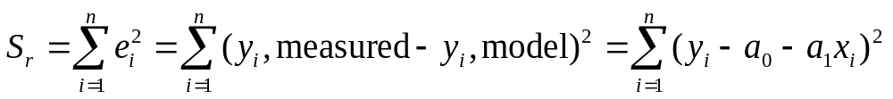
Least Squares Regression
Linear Regression
Best strategy is to minimize the sum of the squares of the residuals between the measured y and the y calculated with the linear model:
Yields a unique line for a given set of data.

Slide 11
polyfit
To fit some given data points to a single polynomial, polyfit function is used.
To avoid a highly fluctuating polynomial, one most often wants to fit a low-order polynomial to data.
This usually means that it is necessary to fit the polynomial in a least-squares sense, which just is what the polyfit function does.
p = polyfit (x, y, n)
The polynomial coefficients are returned in a row vector.

Slide 12
polyfit - linear
octave:30> h = [1.55, 1.75, 1.60, 1.90, 1.60, 1.85, 1.65, 1.70, 1.80, 1.72, 1.63];
octave:31> w = [61, 73, 63, 78, 71, 81, 69, 68, 78, 74, 59];
octave:32> p=polyfit(h,w,1)
p = 56.185 -25.316
octave:33> i=1:11
i = 1 2 3 4 5 6 7 8 9 10 11
octave:34> w(i)=56.185 * h(i) - 25.316
w = Columns 1 through 8:
61.771 73.008 64.580 81.435 64.580 78.626 67.389 70.198
Columns 9 through 11:
75.817 71.322 66.266

Slide 13
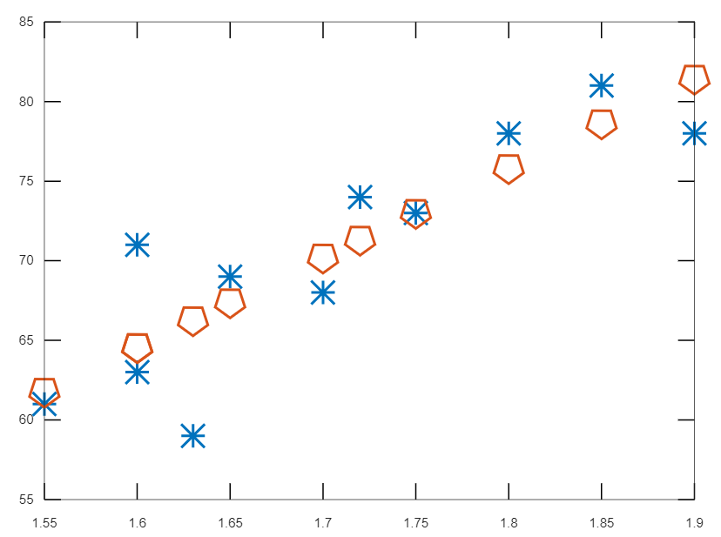
Least Squares Regression

Slide 14
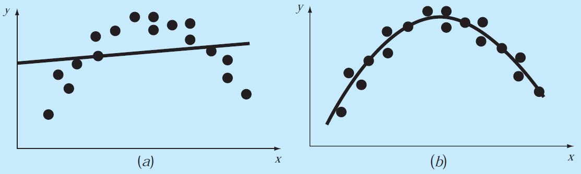
Non-Linear Regression
Linear regression is a powerful technique for best fitting the data.
However, most of the time the data are not linear.

Slide 15
Polynomial Curve Fitting
Least Squares Polynomial Curve Fitting
(Non-Linear Regression)
Given the n data points (x₁, y₁),(x₂, y₂), …,(x_{n}, y_{n}), the least squares polynomial of degree m of the form:
P_{m}(x) = c₁ + c₂ x +c₃ x² + … + c_{m} xᵐ⁻¹ + c_{m}₊₁ xᵐ

Slide 16
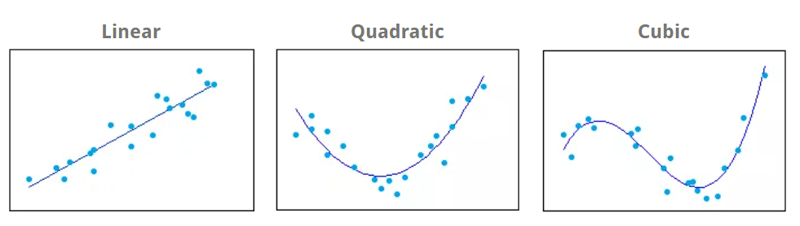
Polynomial Curve Fitting

Slide 17
Example
Perform the curve fitting process using the numerical values in the table given below.
x | -3 | -2 | -1 | 2 | 3 | 4 | 5 | 6
y | 10 | 8 | 3 | 6 | 5 | 3 | 1 | -1

Slide 18
Example
octave:2> x = [-3, -2, -1, 2, 3, 4, 5, 6];
octave:3> y = [10, 5, 1, 5, 4, 2, 0, -1];
octave:4> polyfit(x, y, 1)
ans = -0.9088 5.9654
octave:5> polyfit(x, y, 2)
ans = -0.055603 -0.753537 6.416525
octave:6> polyfit(x, y, 3)
ans = -0.102445 0.516726 -0.083558 1.852245
octave:7> i=1:8;
octave:8> y1 = -0.9088 * x(i) + 5.9654;
octave:9> y2 = -0.055603 * x(i).^2 -0.753537 * x(i) + 6.416525;
octave:10> y3 = -0.079019 * x(i).^3 + 0.343874 * x(i).^2 - 0.214134 * x(i) + 4.269825;

Slide 19
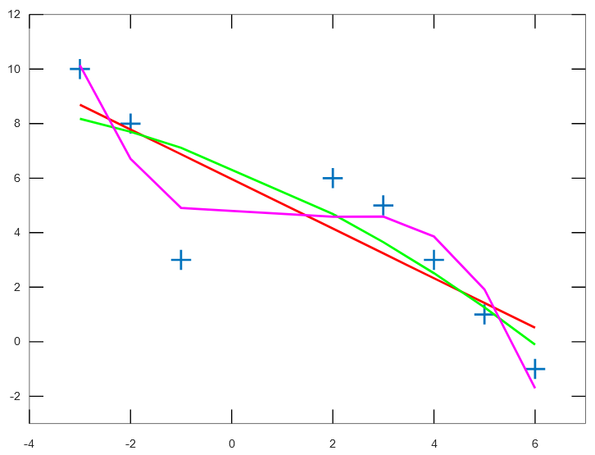
Example
plot(x,y, 'Marker', '+', 'LineStyle', 'none')
hold on
plot(x, y1, 'r', 'LineWidth', 2 )
plot(x, y2, 'g', 'LineWidth', 2)
plot(x, y3, 'm', 'LineWidth', 2 )
axis([-4 7 -3 12])

Slide 20
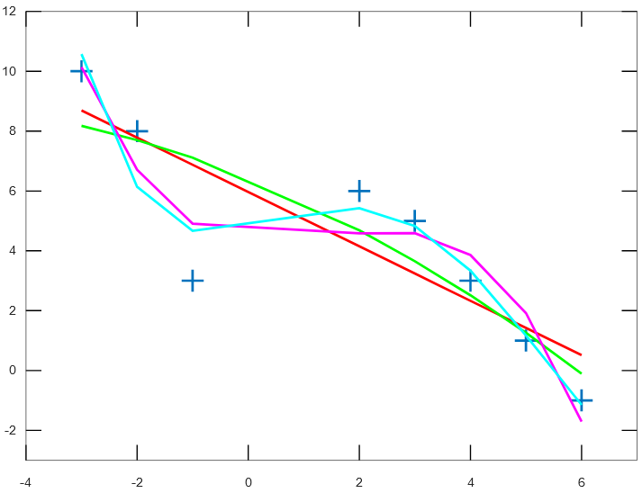
Example
octave:17> polyfit(x, y, 4)
ans = 0.013645 -0.155914 0.206623 0.445464 4.737268
octave:18> y4 = 0.013645 * x(i).^4 - 0.155914 * x(i).^3 + 0.206623 * x(i).^2 + 0.445464 * x(i) + 4.737268
y4 = 10.5754 6.1385 4.6680 5.4257 4.8288 3.3397 1.1690 -1.1450
octave:19> plot(x, y4, 'c', 'LineWidth', 2)

Slide 21
splinefit
In situations where a single polynomial isn’t good enough, a solution is to use several polynomials pieced together.
The function splinefit fits a piecewise polynomial (spline) to a set of data.
pp = splinefit (x, y, breaks)
Fit a piecewise cubic spline with breaks (knots) breaks to the noisy data, x and y.

Slide 22
splinefit
octave:9> x = 2 * pi * rand (1, 200);
octave:10> y = sin (x) + sin (2 * x) + 0.2 * randn (size (x));
octave:11> breaks = linspace (0, 2 * pi, 41);
octave:12> pp1 = splinefit (x, y, breaks);
octave:13> pp2 = splinefit (x, y, 10);
octave:14> xx = linspace (0, 2 * pi, 400);
octave:15> y1 = ppval (pp1, xx);
octave:16> y2 = ppval (pp2, xx);

Slide 23
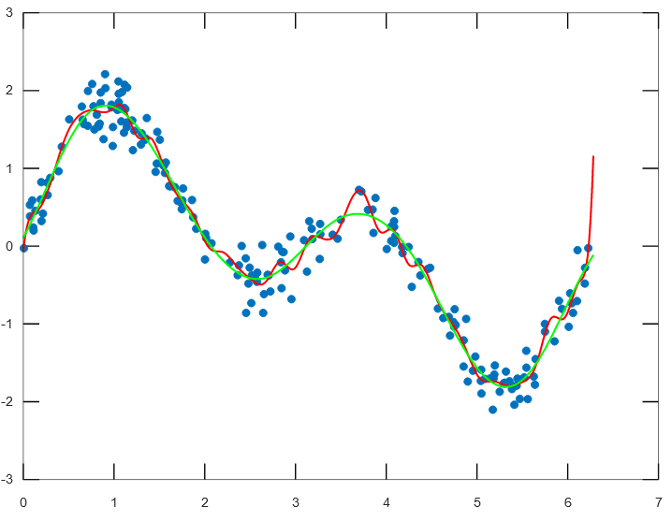
splinefit
plot (x, y, ".", xx, y1, 'r', 'LineWidth', 1.5, xx, y2, 'g', 'LineWidth', 1.5)

